Slide 1
Week 5: More Graph Algorithms
CS 5800
Dr. Alan Jamieson

Slide 2
What’re we talking about today, Alan?
A bunch of algorithms
Shortest path
Dijkstra’s Algorithm
Bellman-Ford Algorithm
Subset parameter optimization
Matchings
Domination

Slide 3
To start:
Could we use one of the techniques we talked about last week to be able to detect a cycle in a directed graph? Come up with the algorithm.
If you are in a breakout room and need help, use the “Ask for Help” functionality. If you are in a breakout room and finish the exercise, hop back into the main room!

Slide 4
Shortest path problem
What’s the shortest path (walk, route, etc.) from one vertex to another.
Two versions: length (number of hops) and value (weight-sum).
Normally, we consider value and not length.
All-pairs version: can I create a matrix (2D-array) that gives shortest path values for all pairs of vertices? Each entry (i,j) in the matrix gives the shortest path value from vertex i to vertex j.

Slide 5
Recap(?): Dijkstra’s Algorithm
Breadth-first search based algorithm introduced by Edsger Dijkstra in 1956.

Slide 6
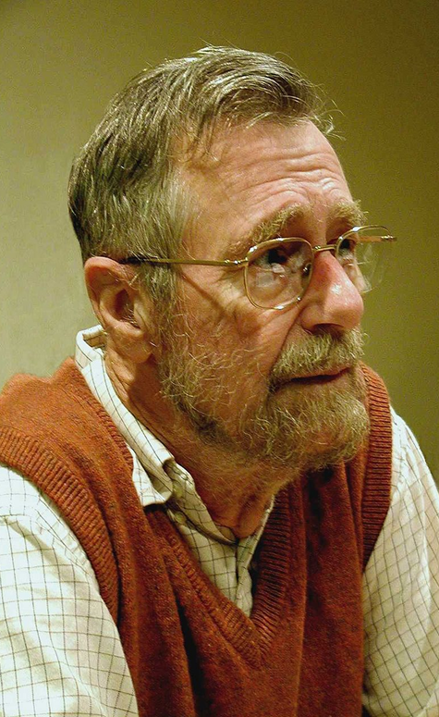
Edsger W. Dijkstra 1930 - 2002
Turing Award Dijkstra Prize Very Opinionated
Photo reproduced under CC BY-SA 3.0 license. Wikipedia.

Slide 7
Consider...
Testing shows the presence, not the absence of bugs.
The use of COBOL cripples the mind; its teaching should, therefore, be regarded as a criminal offense.
Programming is one of the most difficult branches of applied mathematics; the poorer mathematicians had better remain pure mathematicians.
All thanks to Edsger Dijkstra.

Slide 8
Recap(?): Dijkstra’s Algorithm
Breadth-first search based algorithm introduced by Edsger Dijkstra in 1956.
Roughly O(n²) time (actually O(|V|*|E|).
Only works for positively-weighted graphs.
General idea: greedily choose a vertex and update all vertices in its neighborhood that haven’t been visited yet.

Slide 9
Dijkstra’s Algorithm (from Dasgupta)
function dijkstra(G, l, s): Input: Graph G = (V, E), directed or undirected; positive edge lengths (l_e : e in E); vertex s in V Output: For all vertices u reachable from s, dist(u) is set to shortest path distance from s to u for all u in V: dist(u) = inf dist(s) = 0 H = makequeue(V) while H is not empty: u = deletemin(H) for all edges uv in E: if dist(v) > dist(u) + l(u,v): dist (v) = dist(u) + l(u,v) decreasekey(H,v)
makequeue - build a priority queue (based on distance value) deletemin - return the element with the smallest key decreasekey - decrease the key value of an element

Slide 10
Example:

Slide 11
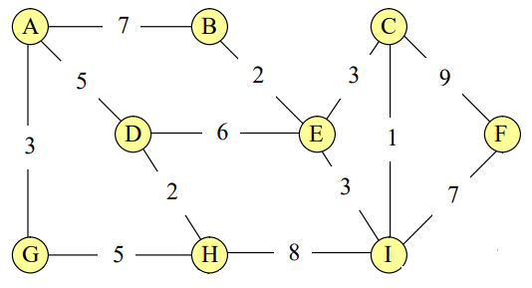
Now you:
Using Dijkstra’s Algorithm, determine the fastest route from vertex A to vertex I.

Slide 12
Query:
Why doesn’t this work for negative edge weights?
How do we fix this?
Notes:
Negative cost cycles can cause infinite loops. Also, because Dijkstra’s is essentially greedy, it’ll never go back across a negative weighted edge and “re-propogate”

Slide 13
Introducing Bellman-Ford
General idea: instead of selecting a single vertex (greedily), we update all vertices by looking at all edges and “relaxing” values as needed.
Starts the same (set source to 0, all other vertices to +inf).
Doesn’t this mean it has the same problem as Dijkstra’s?

Slide 14
Introducing Bellman-Ford
General idea: instead of selecting a single vertex (greedily), we update all vertices by looking at all edges and “relaxing” values as needed.
Starts the same (set source to 0, all other vertices to +inf).
Doesn’t this mean it has the same problem as Dijkstra’s?
Nope, it’ll get around this by restricting the maximum number of update cycles!

Slide 15
Algorithm
function bellman-ford(G, l, s): Input: Directed graph G = (V, E); edge lengths l with no negative cycles vertex s in V Output: For all vertices u reachable from s, dist(u) is min distance from s to u
for all u in V: dist(u) = inf prev(u) = null dist(s) = 0 repeat V-1 times: for all e in E update(e)
function update(uv in E): dist(v) = min{dist(v), dist(u)+l(u,v)}

Slide 16
Example:

Slide 17
Now you:
Using Bellman-Ford, determine the fastest route from vertex A to vertex I. Compare to your answer from the previous exercise.

Slide 18
Shifting gears: subset parameters
Sometimes we want to create a subset of vertices or edges that follow some kind of pattern - these are called subset parameters.
These patterns can be thought of as restrictions.
For instance: every vertex in my subset can’t be adjacent to another vertex in my subset.
A lot of these are simple to state and conceptualize, but very difficult from an algorithmic perspective.

Slide 19
Matching
Formally: S ⊆ E s.t. ∀s ∈ S, N(s) ∩ S = ∅.
N(s) is defined as the open neighborhood of s. When dealing with edges, these are all of the edges that share a vertex with s. Open in this context means that it does not include s itself.
Basically - a subset of edges s.t. no two edges are next to each other.
This is what is called a “maximal” parameter - I’m trying to jam as many edges into S as possible.

Slide 20
Quick note on maximum/maximal
Maximal means that I have a set that I cannot add anything to. This may not be the largest such set!
Maximum is the largest maximal set.
As you’d expect, minimum/minimal is a thing as well.

Slide 21
Example:

Slide 22
Algorithm?
Maximum?
Maximal?
NOW YOU DECIDE!
In your groups, come up with a greedy strategy to get a maximal matching for an arbitrary graph that gets close-ish to optimal.
IS THIS THE WORST? PROBABLY

Slide 23
One more: domination.
Formally - S ⊆ V s.t. ∀s ∈ V-S, |N(s) ∩ S| > 0.
Basically - every vertex not in the subset is adjacent to at least one vertex in the subset.
Lots of variations here, and quite a few applications (think resource management).

Slide 24
Example:

Slide 25
Algorithm?
Minimum?
Minimal?
NOW YOU DECIDE!
In your groups, come up with a greedy strategy to get a minimal dominating set for an arbitrary graph that gets close-ish to optimal.

Slide 26
On your radar:
Homework #3: due tonight
Homework #4: available now, due next week
Synthesis #2: available Thursday, due November 1st
Synthesis #1 grades out by October 18th
Reading: (Dasgupta) Chapter 5; (Skiena) 8.1, 21.5

